Slide 1

21CSC201J DATA STRUCTURES AND ALGORITHMS UNIT-5 Topic : Topological sorting

Slide 2
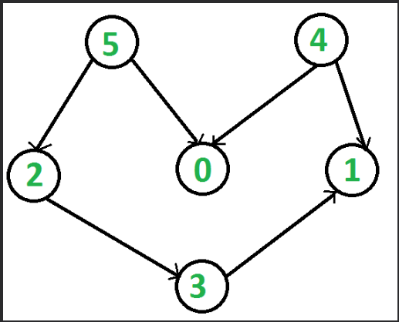
Definition
Topological sorting for Directed Acyclic Graph (DAG) is a linear ordering of vertices such that for every directed edge u v, vertex u comes before v in the ordering.
Note: Topological Sorting for a graph is not possible if the graph is not a DAG.

Slide 3
Topo sort example
How many valid topological sort orderings can you find for the vertices in the graph below?
[A, B, C, D, E, F], [A, B, C, D, F, E],
[A, B, D, C, E, F], [A, B, D, C, F, E],
[B, A, C, D, E, F], [B, A, C, D, F, E],
[B, A, D, C, E, F], [B, A, D, C, F, E],
[B, C, A, D, E, F], [B, C, A, D, F, E],
...
What if there were a new vertex G unconnected to the others?
C
F
B
E
D
A

Slide 4
Topo sort: Algorithm 1
function topologicalSort():
ordering := { }.
Repeat until graph is empty:
Find a vertex v with in-degree of 0 (no incoming edges).
(If there is no such vertex, the graph cannot be sorted; stop.)
Delete v and all of its outgoing edges from the graph.
ordering += v .
C
F
B
E
D
A

Slide 5
Topo sort example
function topologicalSort():
ordering := { }.
Repeat until graph is empty:
Find a vertex v with in-degree of 0 (no incoming edges).
(If there is no such vertex, the graph cannot be sorted; stop.)
Delete v and all of its outgoing edges from the graph.
ordering += v .
ordering = { B }
C
F
B
E
D
A

Slide 6
Topo sort example
function topologicalSort():
ordering := { }.
Repeat until graph is empty:
Find a vertex v with in-degree of 0 (no incoming edges).
(If there is no such vertex, the graph cannot be sorted; stop.)
Delete v and all of its outgoing edges from the graph.
ordering += v .
ordering = { B, C }
C
F
B
E
D
A

Slide 7
Topo sort example
function topologicalSort():
ordering := { }.
Repeat until graph is empty:
Find a vertex v with in-degree of 0 (no incoming edges).
(If there is no such vertex, the graph cannot be sorted; stop.)
Delete v and all of its outgoing edges from the graph.
ordering += v .
ordering = { B, C, A }
C
F
B
E
D
A

Slide 8
Topo sort example
function topologicalSort():
ordering := { }.
Repeat until graph is empty:
Find a vertex v with in-degree of 0 (no incoming edges).
(If there is no such vertex, the graph cannot be sorted; stop.)
Delete v and all of its outgoing edges from the graph.
ordering += v .
ordering = { B, C, A, D }
C
F
B
E
D
A

Slide 9
Topo sort example
function topologicalSort():
ordering := { }.
Repeat until graph is empty:
Find a vertex v with in-degree of 0 (no incoming edges).
(If there is no such vertex, the graph cannot be sorted; stop.)
Delete v and all of its outgoing edges from the graph.
ordering += v .
ordering = { B, C, A, D, F }
C
F
B
E
D
A

Slide 10
Topo sort example
function topologicalSort():
ordering := { }.
Repeat until graph is empty:
Find a vertex v with in-degree of 0 (no incoming edges).
(If there is no such vertex, the graph cannot be sorted; stop.)
Delete v and all of its outgoing edges from the graph.
ordering += v .
ordering = { B, C, A, D, F, E }
C
F
B
E
D
A

Slide 11
Topo sort: Algorithm 1(C Implementation)
Void topsort( graph G )
{
unsigned int counter;
vertex v, w;
for( counter = 0; counter < NUM_VERTEX; counter++ )
{
v = find_new_vertex_of_indegree_zero( );
if( v = NOT_A_VERTEX )
{
error("Graph has a cycle");
break;
}
top_num[v] = counter;
for each w adjacent to v
indegree[w]--;
}
}
C
F
B
E
D
A

Slide 12
Topo sort: Algorithm 1 Complexity Ananlysis
For each vertex check neighboring vertices indegree, each call to it takes O(|V|) time.
Since there are |V| such calls, the running time of the algorithm is O(|V| 2 )

Slide 13
Ordering a graph
Suppose we have a directed acyclic graph (DAG) of courses, and we want to find an order in which the courses can be taken.
Must take all prereqs before you can take a given course.
Example:
[142, 143, 140, 154, 341, 374, 331, 403, 311, 332, 344, 312, 351, 333, 352, 373, 414, 410, 417, 413, 415]
There might be more than one allowable ordering.
How can we find a valid ordering of the vertices?
Case 1: Case 2:
311
374
373
414
143
351
352
312
332
344
417
331
333
341
140
413
410
403
142
154
415

Slide 14
Topological Sort
topological sort: Given a digraph G = (V, E), a total ordering of G's vertices such that for every edge (v, w) in E, vertex v precedes w in the ordering.
Examples:
determining the order to recalculate updated cells in a spreadsheet
finding an order to recompile files that have dependencies
(any problem of finding an order to perform tasks with dependencies)
311
374
373
414
143
351
352
312
332
344
417
331
333
341
140
413
410
403
142
154
415

Slide 15
Revised algorithm
We don't want to literally delete vertices and edges from the graph while trying to topological sort it; so let's revise the algorithm:
map := {each vertex → its in-degree}.
queue := {all vertices with in-degree = 0}.
ordering := { }.
Repeat until queue is empty:
Dequeue the first vertex v from the queue.
ordering += v.
Decrease the in-degree of all v's neighbors by 1 in the map.
queue += {any neighbors whose in-degree is now 0}.
If all vertices are processed, success. Otherwise, there is a cycle.

Slide 16
Topo sort example 2
function topologicalSort():
map := {each vertex → its in-degree}.
queue := {all vertices with in-degree = 0}.
ordering := { }.
Repeat until queue is empty:
Dequeue the first vertex v from the queue.
ordering += v.
Decrease the in-degree of all v's neighbors by 1 in the map.
queue += {any neighbors whose in-degree is now 0}.
map := { A=0, B=0, C=1, D=2, E=2, F=2 }
queue := { B, A }
ordering := { }
C
F
B
E
D
A

Slide 17
Topo sort example 2
function topologicalSort():
map := {each vertex → its in-degree}.
queue := {all vertices with in-degree = 0}.
ordering := { }.
Repeat until queue is empty:
Dequeue the first vertex v from the queue. // B
ordering += v.
Decrease the in-degree of all v's // C, D neighbors by 1 in the map.
queue += {any neighbors whose in-degree is now 0}.
map := { A=0, B=0, C=0, D=1, E=2, F=2 }
queue := { A, C }
ordering := { B }
C
F
B
E
D
A

Slide 18
Topo sort example 2
function topologicalSort():
map := {each vertex → its in-degree}.
queue := {all vertices with in-degree = 0}.
ordering := { }.
Repeat until queue is empty:
Dequeue the first vertex v from the queue. // A
ordering += v.
Decrease the in-degree of all v's // D neighbors by 1 in the map.
queue += {any neighbors whose in-degree is now 0}.
map := { A=0, B=0, C=0, D=0, E=2, F=2 }
queue := { C, D }
ordering := { B, A }
C
F
B
E
D
A

Slide 19
Topo sort example 2
function topologicalSort():
map := {each vertex → its in-degree}.
queue := {all vertices with in-degree = 0}.
ordering := { }.
Repeat until queue is empty:
Dequeue the first vertex v from the queue. // C
ordering += v.
Decrease the in-degree of all v's // E, F neighbors by 1 in the map.
queue += {any neighbors whose in-degree is now 0}.
map := { A=0, B=0, C=0, D=0, E=1, F=1 }
queue := { D }
ordering := { B, A, C }
C
F
B
E
D
A

Slide 20
Topo sort example 2
function topologicalSort():
map := {each vertex → its in-degree}.
queue := {all vertices with in-degree = 0}.
ordering := { }.
Repeat until queue is empty:
Dequeue the first vertex v from the queue. // D
ordering += v.
Decrease the in-degree of all v's // F, E neighbors by 1 in the map.
queue += {any neighbors whose in-degree is now 0}.
map := { A=0, B=0, C=0, D=0, E=0, F=0 }
queue := { F, E }
ordering := { B, A, C, D }
C
F
B
E
D
A

Slide 21
Topo sort example 2
function topologicalSort():
map := {each vertex → its in-degree}.
queue := {all vertices with in-degree = 0}.
ordering := { }.
Repeat until queue is empty:
Dequeue the first vertex v from the queue. // F
ordering += v.
Decrease the in-degree of all v's // none neighbors by 1 in the map.
queue += {any neighbors whose in-degree is now 0}.
map := { A=0, B=0, C=0, D=0, E=0, F=0 }
queue := { E }
ordering := { B, A, C, D, F }
C
F
B
E
D
A

Slide 22
Topo sort example 2
function topologicalSort():
map := {each vertex → its in-degree}.
queue := {all vertices with in-degree = 0}.
ordering := { }.
Repeat until queue is empty:
Dequeue the first vertex v from the queue. // E
ordering += v.
Decrease the in-degree of all v's // none neighbors by 1 in the map.
queue += {any neighbors whose in-degree is now 0}.
map := { A=0, B=0, C=0, D=0, E=0, F=0 }
queue := { }
ordering := { B, A, C, D, F, E }
C
F
B
E
D
A

Slide 23
Topo sort runtime
What is the runtime of our topological sort algorithm?
(with an "adjacency map" graph internal representation)
function topologicalSort():
map := {each vertex → its in-degree}. // O(V)
queue := {all vertices with in-degree = 0}.
ordering := { }.
Repeat until queue is empty: // O(V)
Dequeue the first vertex v from the queue. // O(1)
ordering += v. // O(1)
Decrease the in-degree of all v's // O(E) for all passes neighbors by 1 in the map.
queue += {any neighbors whose in-degree is now 0}.
Overall: O(V + E) ; essentially O(V) time on a sparse graph (fast!)

Slide 24
Topo sort: Algorithm 2 (C Implementation)
Void topsort( graph G )
{
QUEUE Q;
unsigned int counter;
vertex v, w;
Q = create_queue( NUM_VERTEX ); make_null( Q ); counter = 0;
for each vertex v
if( indegree[v] = 0 )
enqueue( v, Q );
while( !is_empty( Q ) )
{
v = dequeue( Q );
top_num[v] = ++counter; /* assign next number */
for each w adjacent to v
if( --indegree[w] = 0 )
enqueue( w, Q );
}
f( counter != NUM_VERTEX )
error("Graph has a cycle");
dispose_queue( Q ); /* free the memory */
}
i

Slide 25
TopSort: Applications
Finding cycle in a graph
Operation System deadlock detection
Dependency resolution
Sentence Ordering
Critical Path Analysis
Course Schedule problem
Other applications like manufacturing workflows, data serialization and context-free grammar.

Slide 26
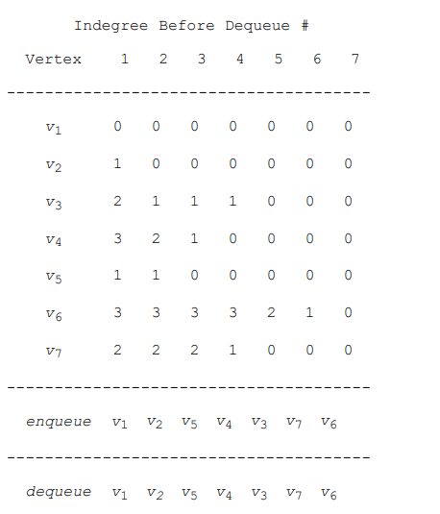
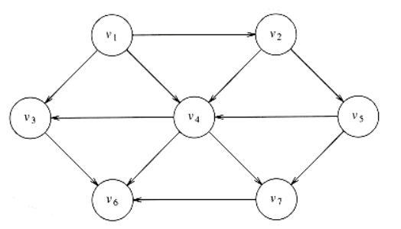
Practice Question

Slide 27
Review Questions
1.Topological sort can be applied to which of the following graphs?
a) Undirected Cyclic Graphs b) Directed Cyclic Graphs c) Undirected Acyclic Graphs d) Directed Acyclic Graphs
2. Most Efficient Time Complexity of Topological Sorting is? (V – number of vertices, E – number of edges) a) O(V + E) b) O(V) c) O(E) d) O(V*E)
3. In most of the cases, topological sort starts from a node which has ___ a) Maximum Degree b) Minimum Degree c) Any degree d) Zero Degree
4. Topological sort of a Directed Acyclic graph is? a) Always unique b) Always Not unique c) Sometimes unique and sometimes not unique d) Always unique if graph has even number of vertices

